Slide 1
EMS702UP Statistical Thinking and Applied Machine Learning
W1.1 Introduction to Statistics and Machine Learning
Jun Chen

Slide 2
Introduction to Statistics
Statistics is a collection of tools that you can use to get answers to important questions about data.
Descriptive statistical methods to transform raw observations into information that you can understand and share.
Inferential statistical methods to reason from small samples of data to whole domains (population).
Statistical methods refer to a range of techniques
Summary statistics intended to help better understand data
Statistical hypothesis tests and estimation statistics that can be used to interpret the results of experiments and predictions from models.
Statistical methods are used at each step in an applied machine learning project.

Slide 3
Introduction to Statistics
Machine learning practitioners have to experiment, analyse data and reach defensible conclusions about the outcomes of their experiments to determine how predictive models/algorithms behave when tested under real conditions.
Statistical methods will impact your practice of machine learning in the following ways:
Use descriptive statistics and data visualizations to quickly and more deeply understand the shape and relationships in data and model skill (performance) and model predictions.
Use inferential statistical tests to quickly and effectively quantify the relationships between samples, such as the results of experiments with different predictive algorithms or differing configurations.
Use estimation statistics to quickly and effectively quantify the confidence in estimated model skill and model predictions.

Slide 4
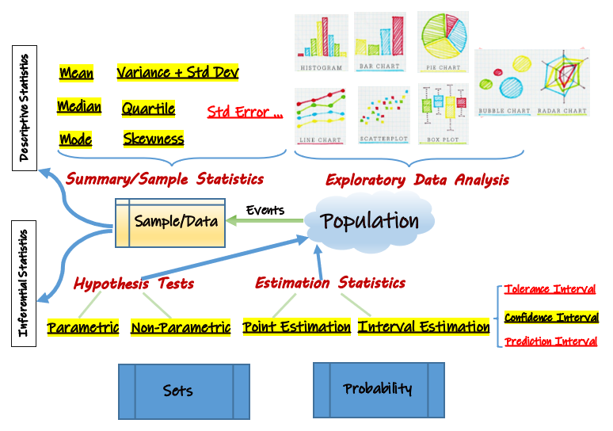
The Map of Statistics

Slide 5
Terminologies
Experiment: An activity with an observable result, or set of results.
Outcome: An outcome is simply an observable result of an experiment.
Sample Space: A sample space is the set of all possible outcomes of an experiment.
Event: An outcome or set of outcomes to an experiment of interest to the experimenter.
Population: All members that belong to a certain group.
Sample: Some observed members of the population.

Slide 6
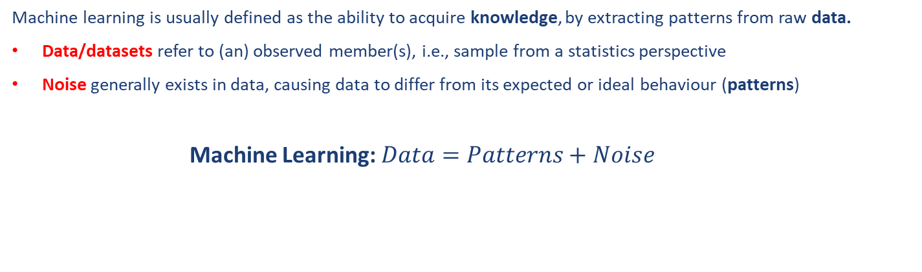
Introduction to Machine Learning
Machine learning is usually defined as the ability to acquire knowledge, by extracting patterns from raw data.
Data/datasets refer to (an) observed member(s), i.e., sample from a statistics perspective
Noise generally exists in data, causing data to differ from its expected or ideal behaviour (patterns)
Machine Learning: $Data=Patterns+Noise$

Slide 7
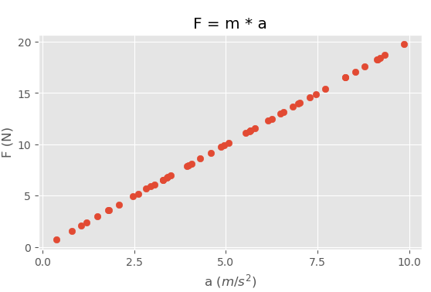
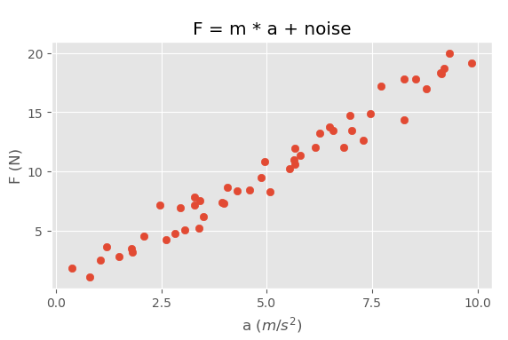
Introduction to Machine Learning – An Example

Slide 8
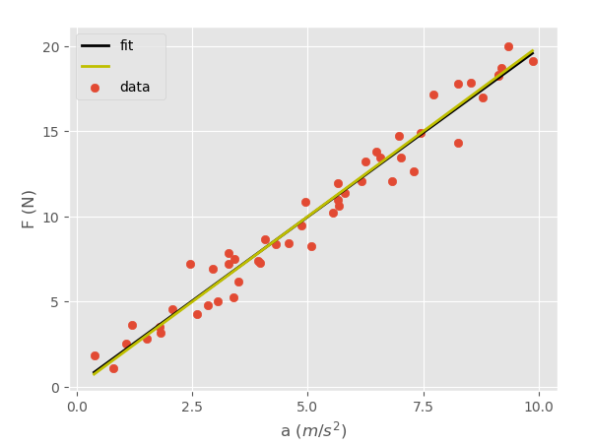
Introduction to Machine Learning – An Example
With linear regression (a machine/statistical learning algorithm you will learn in Week 6), we can find a very close approximation to $m∗a$, even through the algorithm does not know it in beforehand.

Slide 9
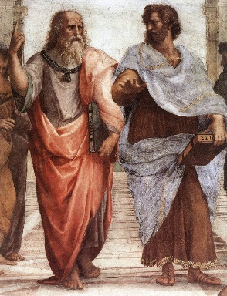

Machine Learning – Problem of Universals
Universals are the things that two or more entities have in common and a universal has instances called particulars.
Problem of Universals: $What we see=Universals+Particular properties$

Slide 10
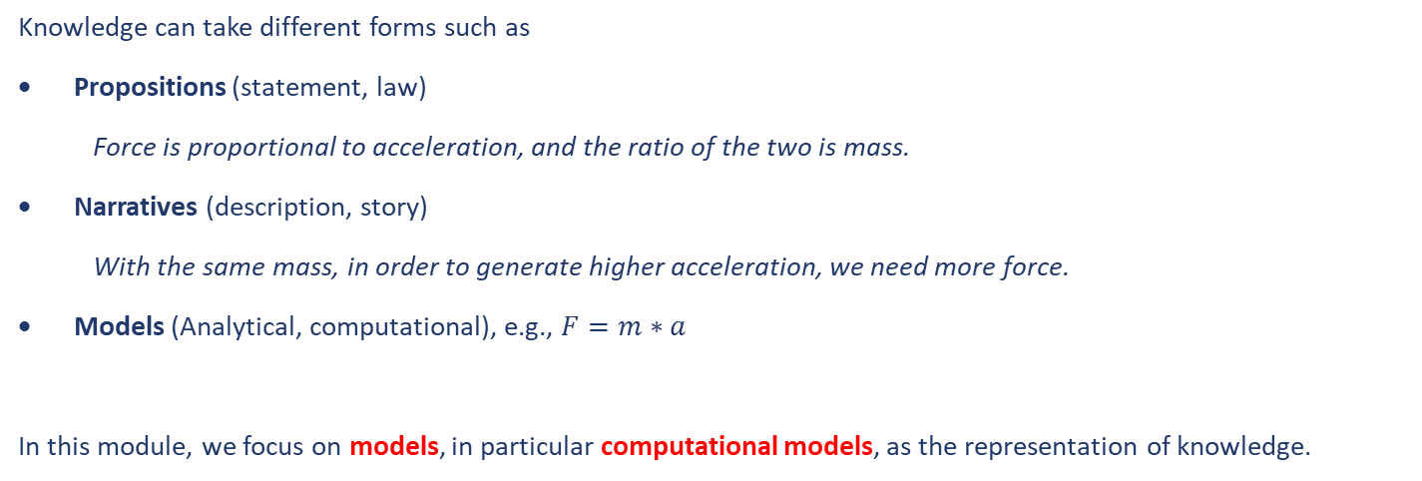
Machine Learning – Knowledge Representation
Knowledge can take different forms such as
Propositions (statement, law)
Force is proportional to acceleration, and the ratio of the two is mass.
Narratives (description, story)
With the same mass, in order to generate higher acceleration, we need more force.
Models (Analytical, computational), e.g., $F=m∗a$
In this module, we focus on models, in particular computational models, as the representation of knowledge.

Slide 11
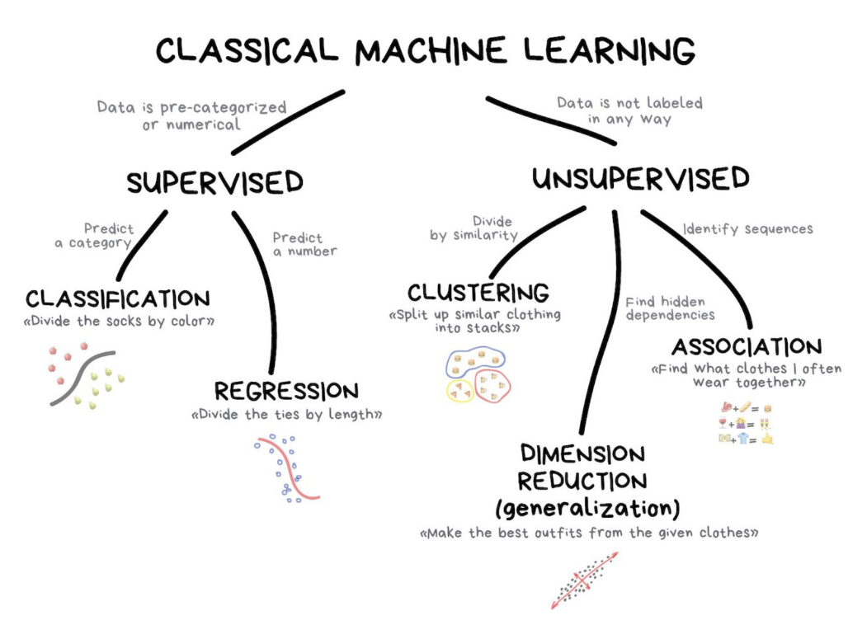
The Map of Machine Learning

Slide 12
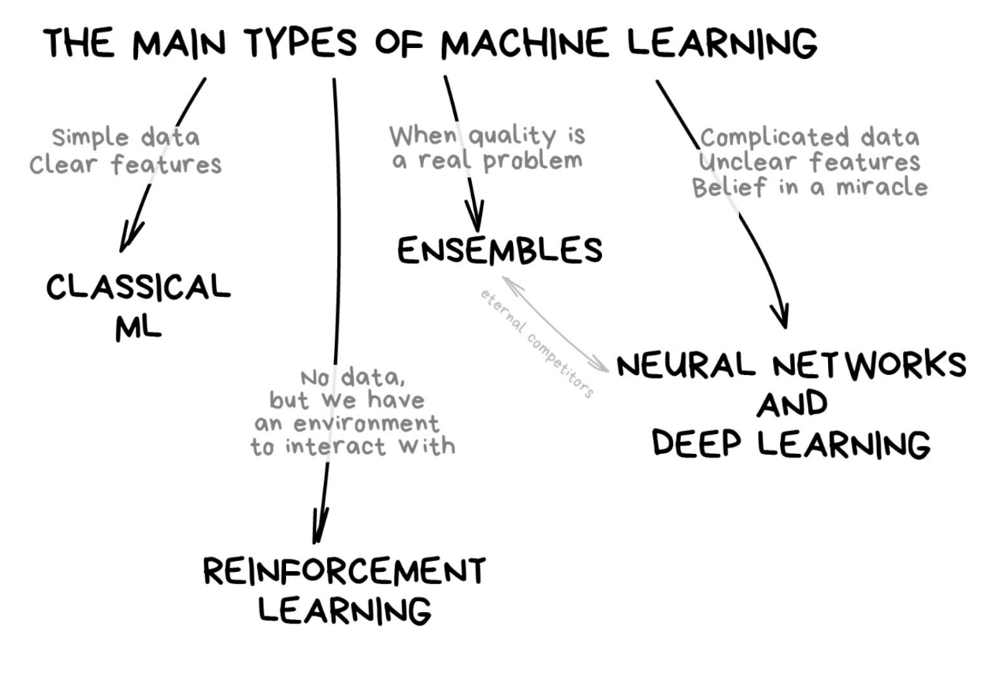
The Map of Machine Learning

Slide 13
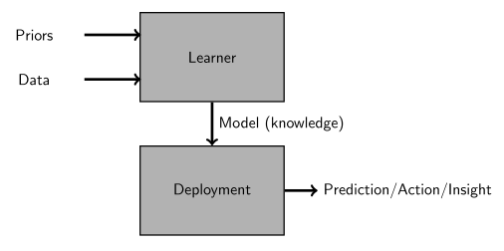
Machine Learning Basic Methodology
Learning stage: The model is built
Deployment stage: The model is used
Model quality (skill, performance): Finding the best model that work well during deployment, i.e., when presented with new data
Training: A model is created using data and a quality metric. We also say that we fit a model to a dataset.
Testing: The performance of the model during deployment is assessed using new, unseen data.

Slide 14
End slide

